Slide 1
HARNEY SOIL AND WATER CONSERVATION DISTRICT
Annual Meeting 2/22/2024

Slide 2
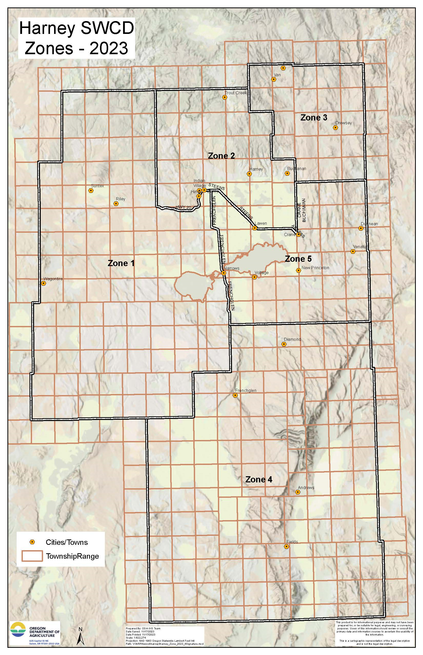
Harney SWCD Board of Directors
Zone 1: Susan Doverspike
Zone 2: Scott Franklin (Vice Chair)
Zone 3: Carol Dunten
Zone 4: Stacy Davies
Zone 5: Ken Bentz
At large 1: Ryan Peila (Sec/Treas)
At Large 2: Jeff Hussey (Chair)

Slide 3
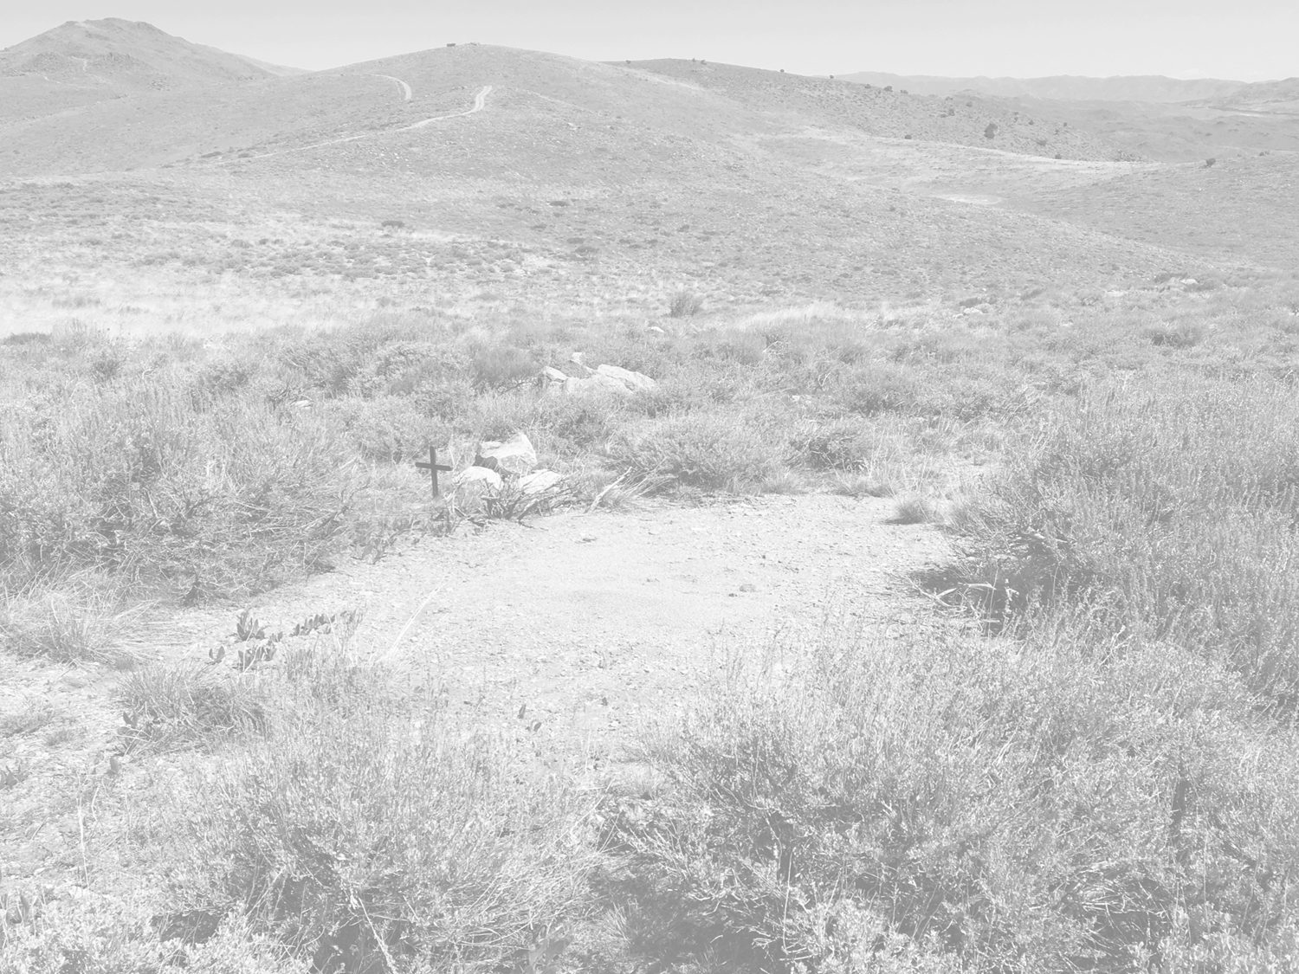
STAFF
Jason Kesling, District Manager
Barbara Pearson, Administration Assistant
Sarah Mundy, CCAA Coordinator
Danielle Reynolds, NRCS Partner Biologist
Tyler Goss, Harney CWMA Coordinator
Sam Artaiz, SONEC Partner Biologist
Breanna O’Connor, CCAA/Ag Water Specialist
April Mack, Rangeland Biologist

Slide 4
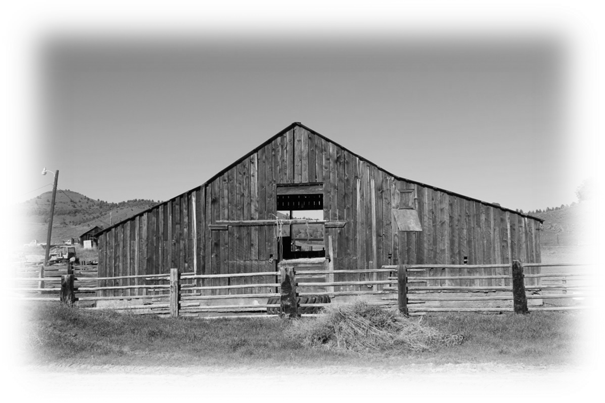
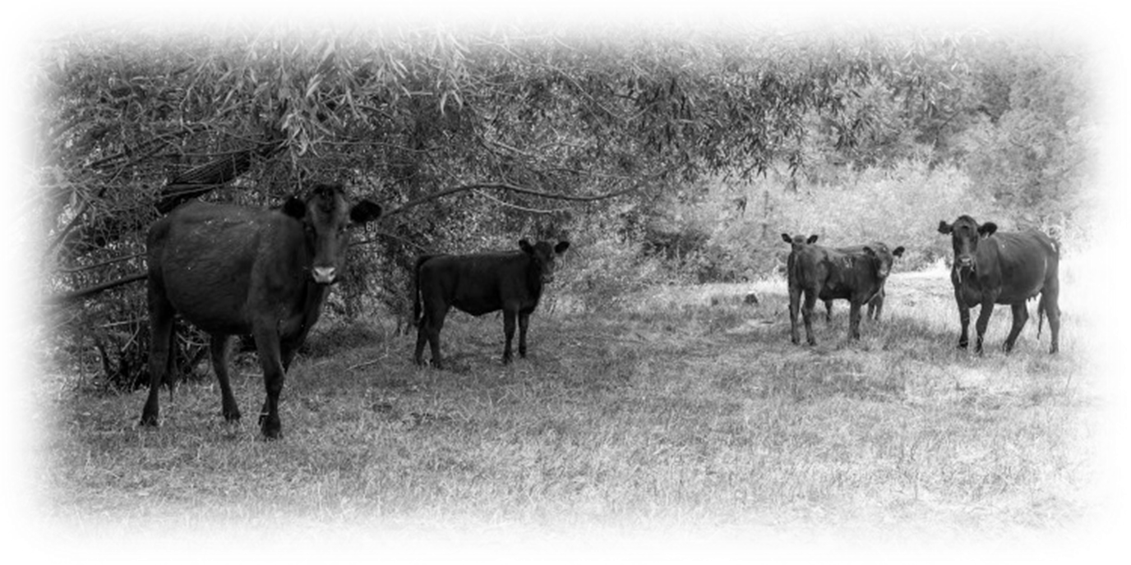
MISSION
To conserve, protect and enhance natural resources for the social, economic, and environmental benefit of the people of Harney County.

Slide 5
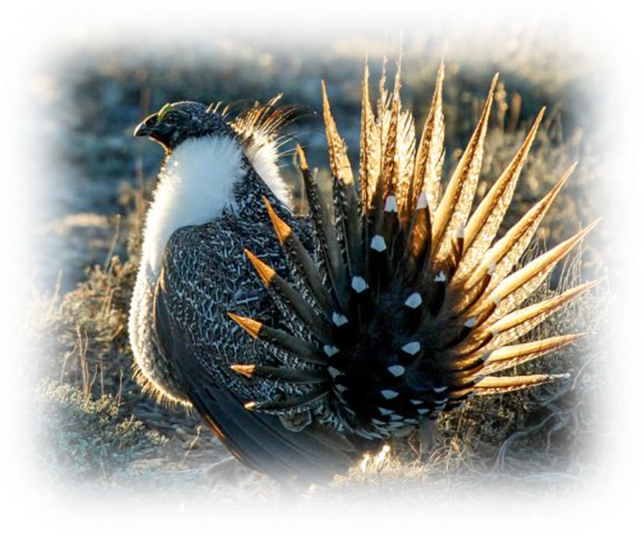
Current Programs
Sage grouse Candidate Conservation Agreement with Assurances (CCAA)
SONEC Wetlands (Southern Oregon/Northeastern California)
Harney Cooperative Weed Management Area (CWMA)
Malheur River SIA
Silvies River Focus Area (ODA)
OWEB Small Grants
Range Drill Rental
Solar Trailers Rental

Slide 6
PRIORITY AREAS
Range Health
Forest Health
Ecosystem Health
Ag Water Quality
Ag Energy
Juniper Encroachment
Invasive Species
Grazing management
Coordinated landscape resource management
Complement NRCS sage grouse Initiative (SGI)
Precommercial thinning
Portable solar watering systems for permitees
Fuels reduction
HCRC participation
Landscape resource management
Greater sage grouse Candidate Conservation Agreement w/Assurances (CCAA) outreach & site specific plan development
Basin carp removal
Invasive species
Development of outreach strategy within the Silvies River Demonstration Area
Maintain or improve stream bank vegetation based on site potential and other factors
Reducing energy demand on Harney Electric by improving irrigation efficiency through installing new technology
Solar livestock watering systems: portable & fixed

Slide 7
Snapshot of 2023

Slide 8
2023 Accomplishments
Secured Funding
SOWR II Weed and Juniper Treatment ($1,825,750)
Juniper (2,499 private and 1,791 State) Weed (3,100 acres)
OWEB
Trout Creek Diversion ($75,000)
NACD 2023 TA Grant ($71,345)
USFWS Infrastructure Bill Money ($25,000)
ODA TA and Operation ($193,188, 2 years)
SONEC ($66,975)
Pheasant Forever ($288,758, 3 years)
HB 2010 Juniper Cut ($300,000)
BLM Rangeland ($89,500)
OSWB Grants 3 Projects ($26,823)
Completed Funding
Harney Irrigation
SOWR (4,074.7 acres of juniper, 13,500 acres of medusahead treatment)
Baker Corral (1,273 acres)
7 Small Grants (Water developments and Juniper cutting)
Staff
7 SWCD and 1 CWMA was full staff for the entire year
Improvements
Purchased New Pickup for CWMA
Other
2 OWEB FIP Grants (Sage Grouse and Wet Meadows)
Coordinated with Watershed Council on OWEB Grant
SONEC OWEB Request 4

Slide 9
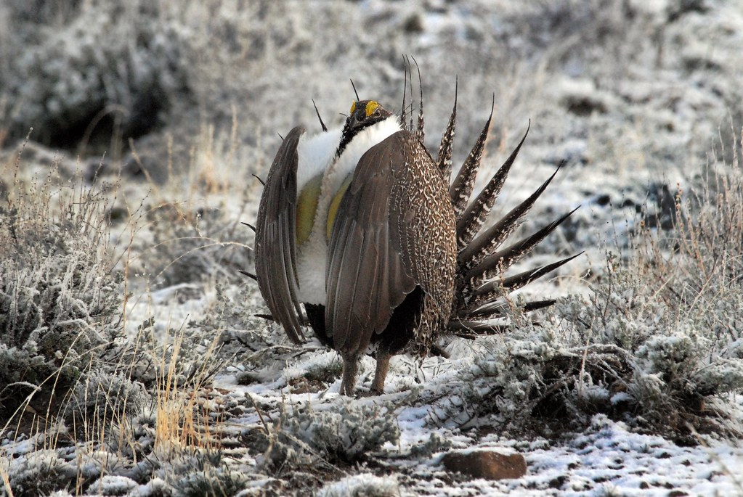
Sage Grouse CCAA Program
Update
For Private Lands in Harney County
This Photo by Unknown Author is licensed under CC BY-NC-ND

Slide 10
End of 2023 Stats
357,948 acres enrolled out of 590,272 possible acres = 61% complete 3,456 acres enrolled in 2023 17,908 acre Plan developed/sent to USFWS and the landowner for edits 36,186 acres - Two developed and pending review by landowners
Conservation on CCAA enrolled properties to date (Approx.)
Conifer Control 13,275 acres
Annual Grass Treatments 13,293 acres
Water Developments 10
Solar pump conversions 4
Trough escape ramps 97
Fence marked 18 miles
Stage of Development | # | 2/13/24 status acres Harney | Priority Habitat |  |  |  | General Habitat | General Habitat
Completed SSP - Enrolled | 24 | 357,948 | 156,913 |  |  |  | 138,604 | 138,604
In progress | 10 | 91,362
Next | 2 | 48,659
Withdrawn | 16 | 43,662
LOI remaining | 25 | 92,303 | 232,324 | (acres) 37 SSP's left to develop
Total | 78 | 633,934 | Acres Enrolled or waiting to be enrolled 590,272

Slide 11
2024 Projects (Staff Salary Secured: 1.824 million)
HB 2010
Mule Creek Juniper- private 900 acres, BLM 2,372 acres
Water Infrastructure (HDP)
SOWR II
Juniper- private 2,499 acres, state 1,791 acres
Weeds -3100 acres
Sage Grouse N. Steens RCPP
NRCS 12 Application Submitted
CWMA Stinkingwater Renewal RCPP
NRCS 6 Application Submitted
CCAA SSP Development
CWMA
Grants: Stinkingwater Purple Loosestrife, BLM Weeds, USFS Title II
SONEC (HDP SB 5506)
7 TA for Irrigation improvements
3 miles of ditch maintenance
NRCS SONEC
12 applicants, potentially 3 funded
Rangeland Drill Rental
Mobile Solar Trailers
Burns BLM Rangeland Improvement Projects
OWEB Small Grants 8-9

Slide 12
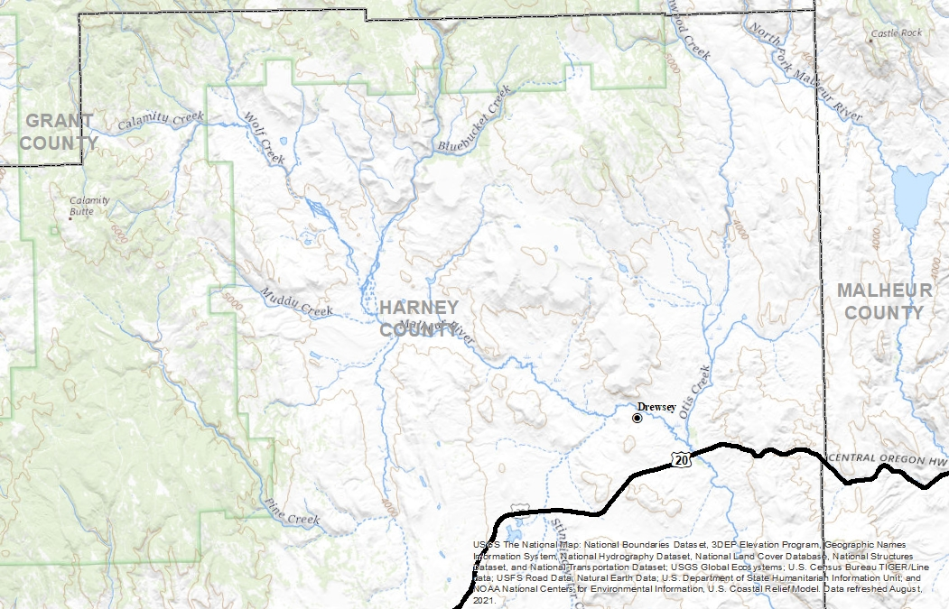
Drewsey Area
Programs for assistance
Title 2 (weeds)
Forest Fringe (NRCS)
NRCS SGI
OWEB Large Grants
SIA
HB 2010 (Mule Creek high priority area)
Proposed Joint Chiefs 2025?

Slide 13
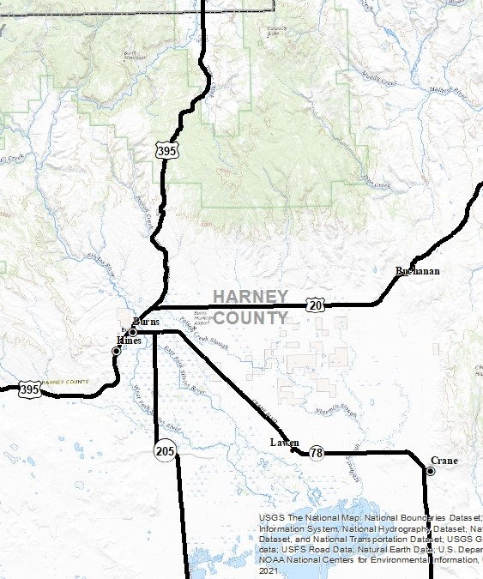
Harney Basin
Programs for assistance
Title 2 (Weeds)
Forest Fringe (NRCS)
OWEB Small Grant
OWEB Large Grant
SONEC
NRCS SGI
NRCS Groundwater
Proposed Joint Chiefs
OWEB FIP Wetlands

Slide 14
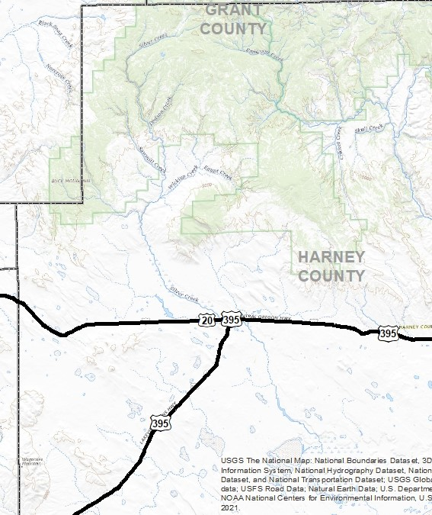
Riley Area
Programs for assistance
Title 2 (Weeds)
Forest Fringe (NRCS)
OWEB Small Grant
OWEB Large Grant
SONEC
NRCS SGI
NRCS Groundwater

Slide 15
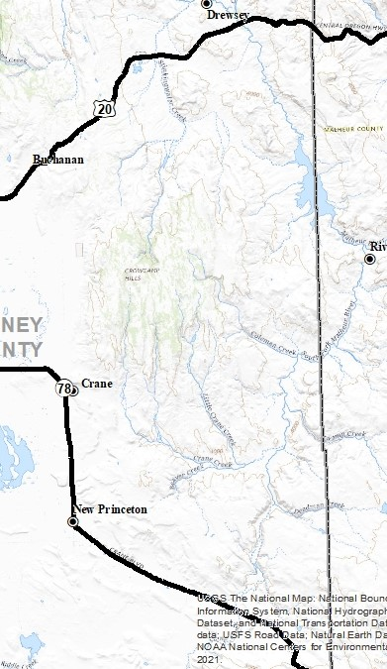
Stinkingwater Area
Programs for assistance
Stinkingwater RCPP
Sage Grouse RCPP
OWEB Small Grants
OWEB Large Grants
NRCS SGI
Proposed FIP 3.0 for SG

Slide 16
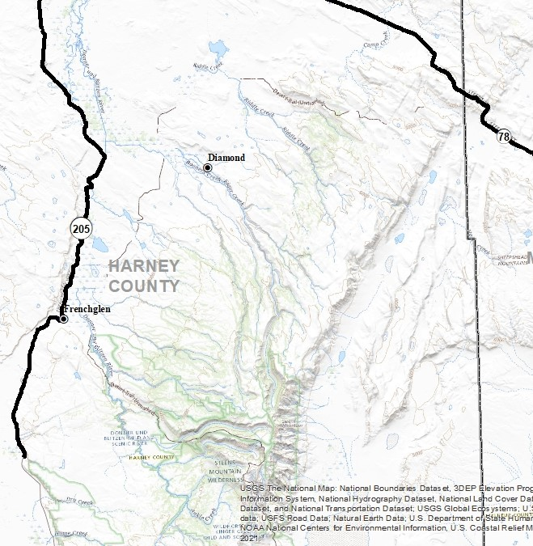
Steens Area
Programs for assistance
Sage Grouse RCPP
OWEB Small Grant
OWEB Large Grant
NRCS SGI
Proposed FIP 3.0 for SG

Slide 17
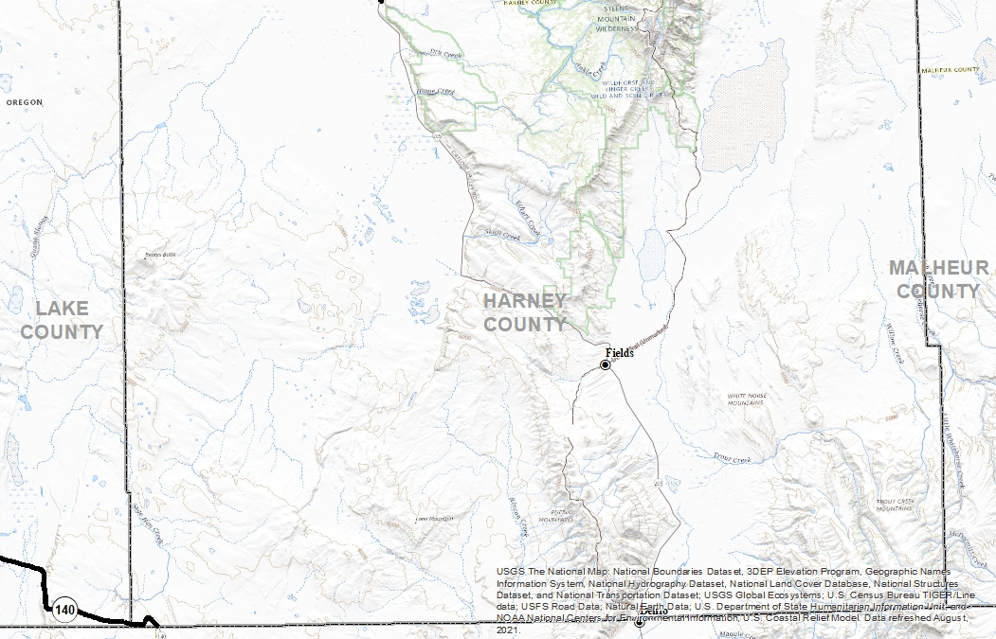
Fields/South County
Programs for assistance
NRCS SGI
OWEB Small Grants
OWEB Large Grants
Proposed FIP 3.0 for SG

Slide 18
Partnership and Collaboration

